Slide 1
BLOOD BANK management system

Slide 2
Introduction
Blood Bank Management System
is a technological opportunity for the peoples who needed blood and can get it as soon as possible.This website is to maintain a relation between the blood donar and blood needer.
Blood bank management system project having two modules:
1. Customer module:
In this module we have to enter name,number,email ID,blood group.After submitting the blood needer would get the call or mail regarding the blood availability within 12 hours.
2. Admin module:
In this module we can add new donar,availability of stock of blood,if the blood is available then he/she would get a call regarding the availability.

Slide 3
Module description Admin module
Login
Admin Actions
Add New Donor
Edit/Delete Donar Details
Manage Stock
RequestForBlood
RequestForBloodDone
RequestForBloodCompleted
Logout.

Slide 4
Customer Module
Name
Mobile number
Email id
Blood group

Slide 5
Key Features
User can Add New donor,edit his personal details.
User could maintain or manage stock availability of Blood.
User maintain all the details regarding the personal details by keeping the details in database.

Slide 6
SOFTWARE AND HARDWARE SPECIFICATIONS
Ungtwlrf Tfqumrfkfots8Olkf ng enkpnofot
Upfemgmeltmno
Npfrltmoi Uystfk
Ymo`nws =:, Ymo`nws ZR, Ymo`nws9,Cmoux
Cloiulif
Rytjno Tuotmkf Fovmrnokfot
@ltldlsf
KyU\C Ufrvfr
Drnwsfr
Loy ng Knzmccl, Npfrl, Ejrnkf fte
Yfd Ufrvfr
@hloin
Ungtwlrf @fvfcnpkfot Amt
Rytjno
Uermptmoi Cloiulif Foldcf
Hlvlsermpt
@ltldlsf H@DE @rmvfr
KyU\C Henoofetnr
Jlr`wlrf Tfqumrfkfots8Olkf ng enkpnofot
Upfemgmeltmno
Rrnefssnr
Rfotmuk MMM 752KJz
TLK
<4: KD
Jlr` `msa
42 ID
Knomtnr
<6‛ encnr knomtnr
Afydnlr`
<44 afys
Software Requirements:
User interface:(Eclipse ,Tomcat ,JSP , Java, MySQL )
Database: MY SQL
Documentation Tool: Ms office.
Windows: 7 or newer
My-Sql-connector-java 8.0.19
Hardware Requirements:
Processor: Minimum 1 GHz; Recommended 2GHz or more
Ethernet connection (LAN) OR a wireless adapter (Wi-Fi)
Hard Drive: Minimum 32 GB; Recommended 64 GB or more
Memory (RAM): Minimum 256Mb; Recommended 4 GB or above
Monitor: Standard color monitor
Keyboard: Standard Keyboard
Mouse: Standard Mouse

Slide 7
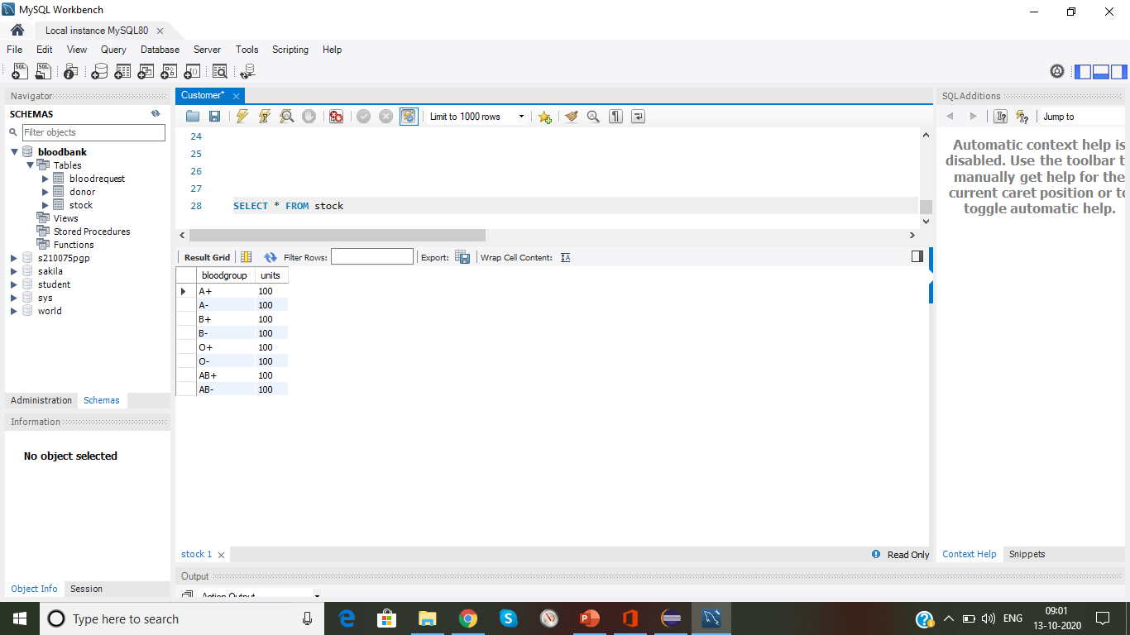
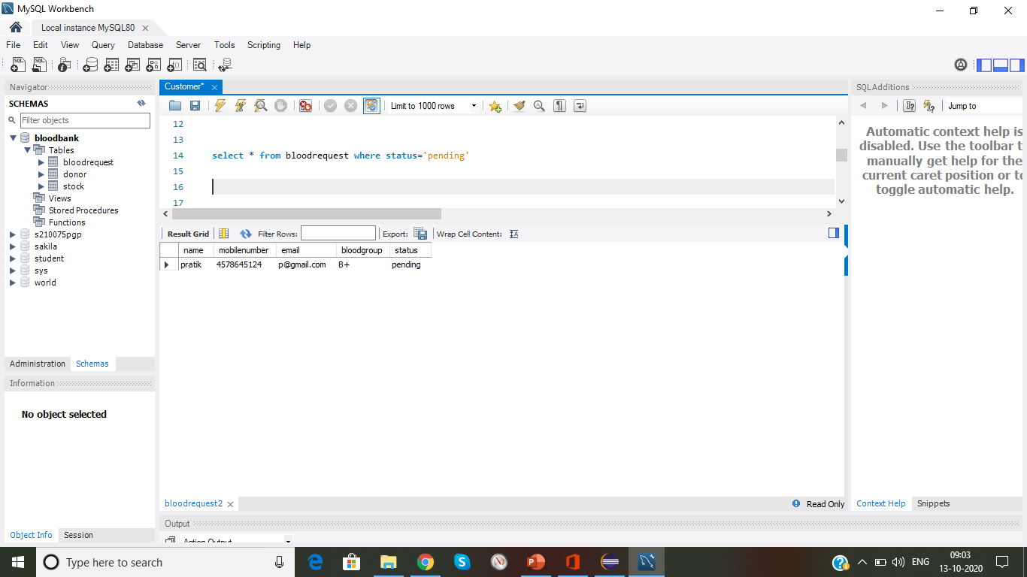
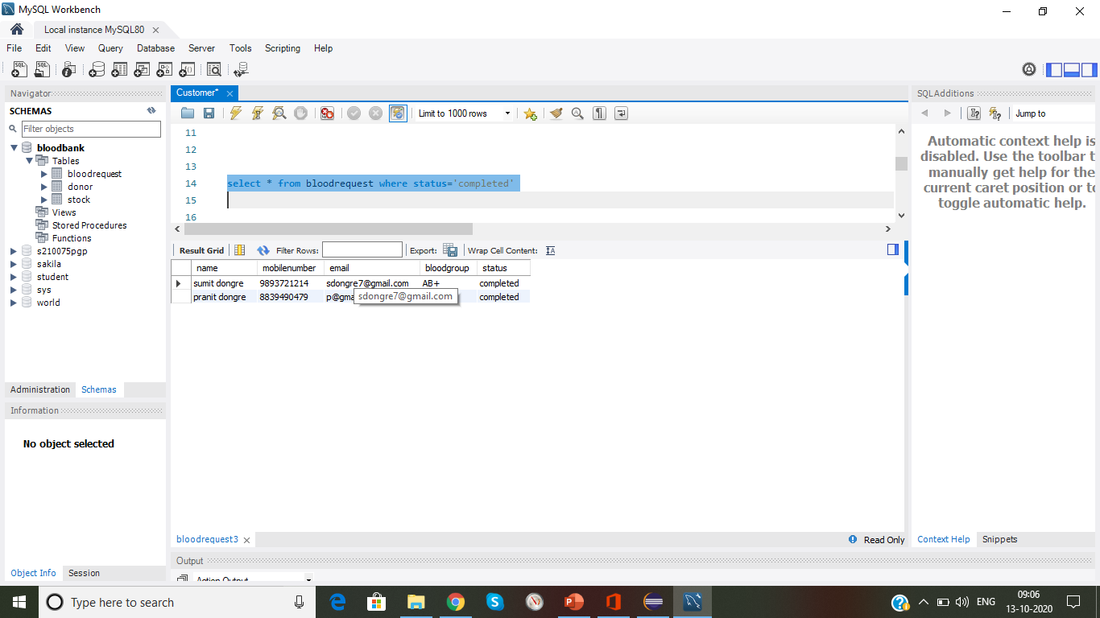
Database Creation

Slide 8
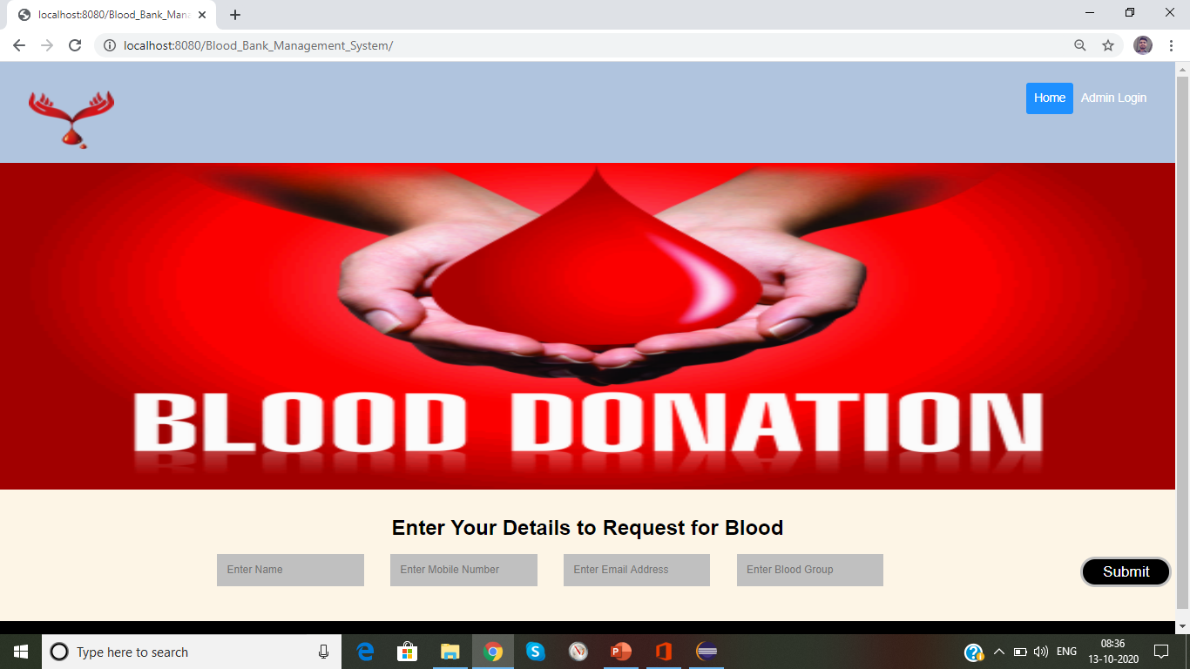
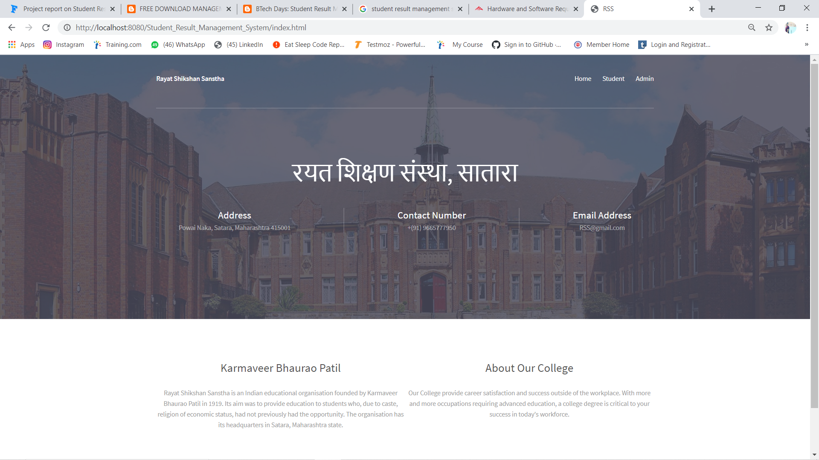

Slide 9
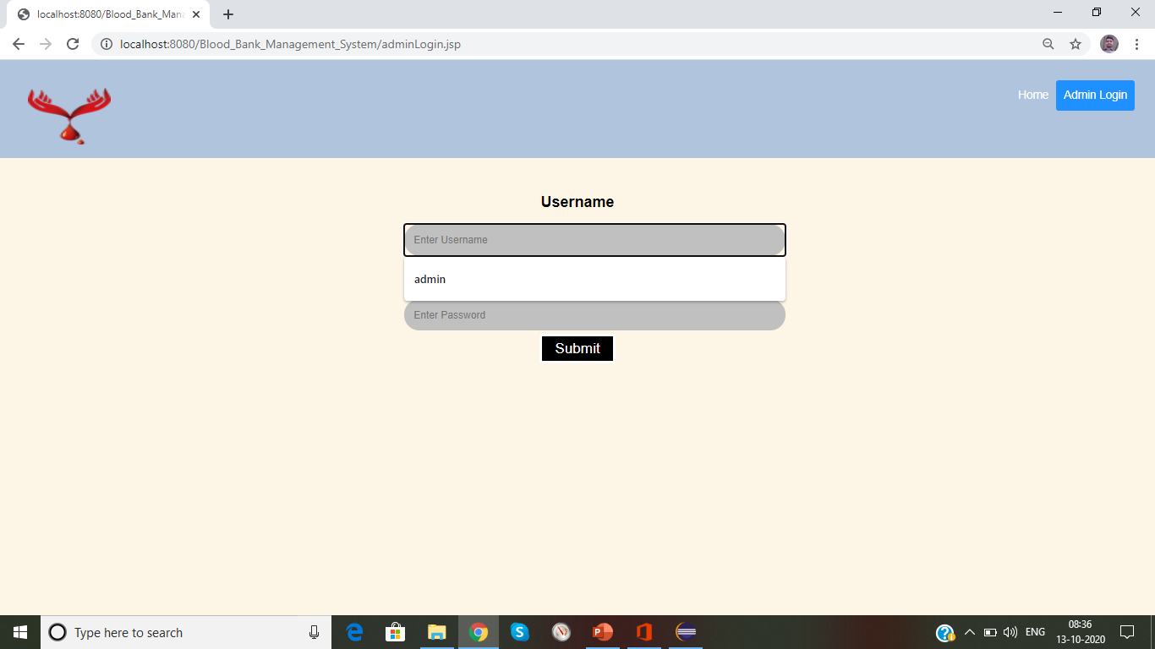
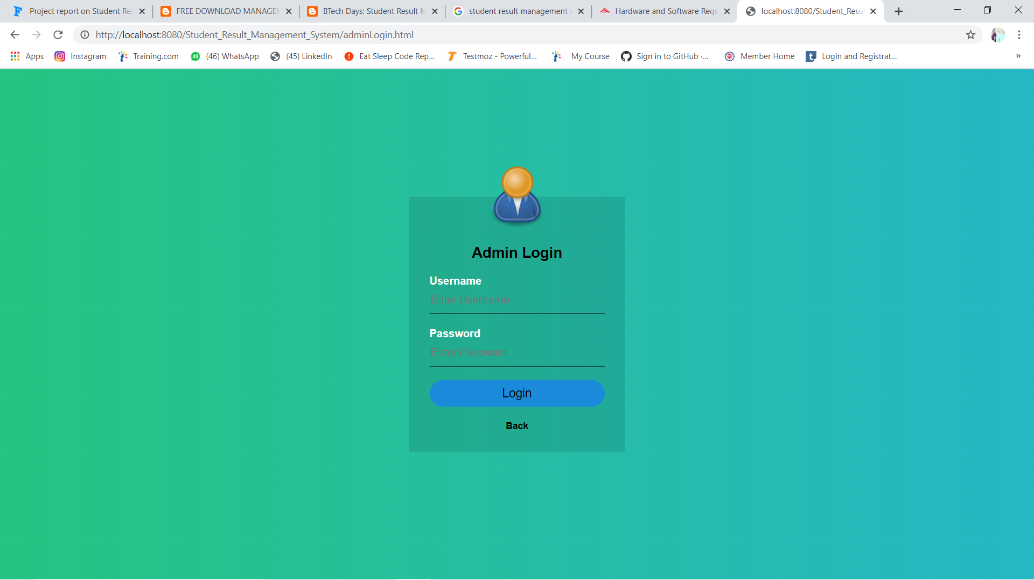

Slide 10
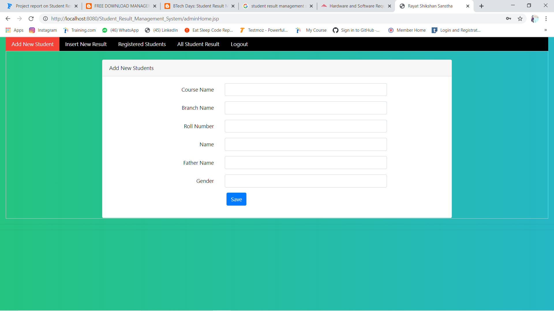
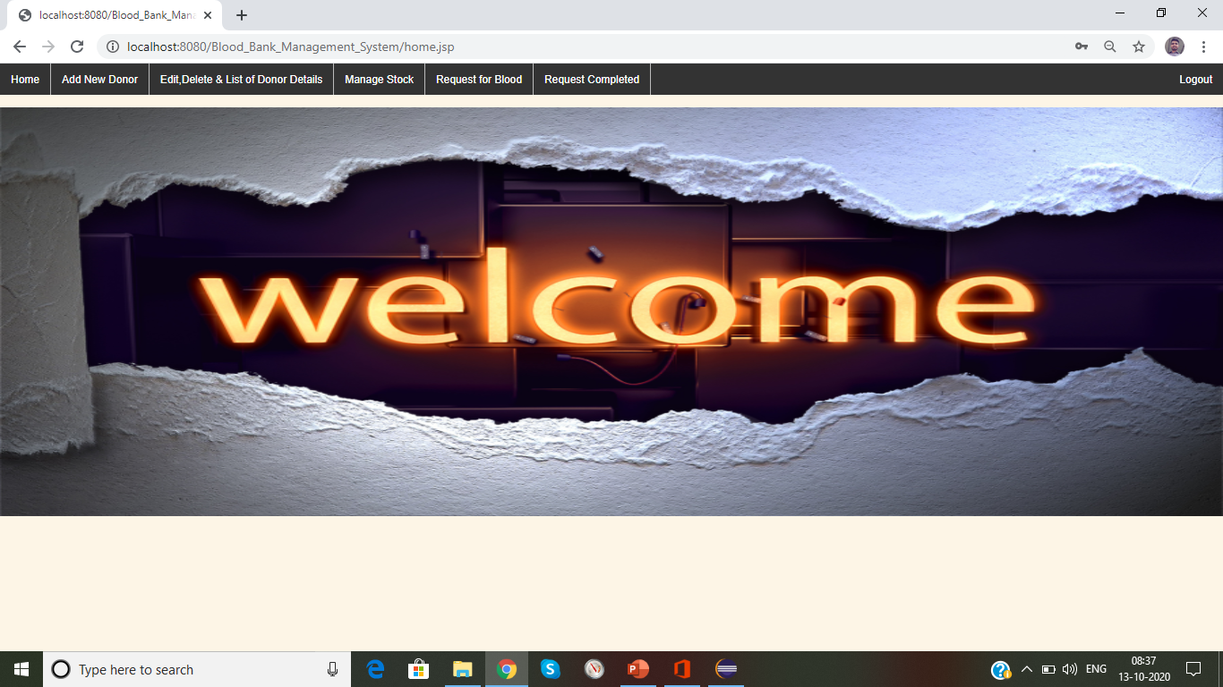

Slide 11
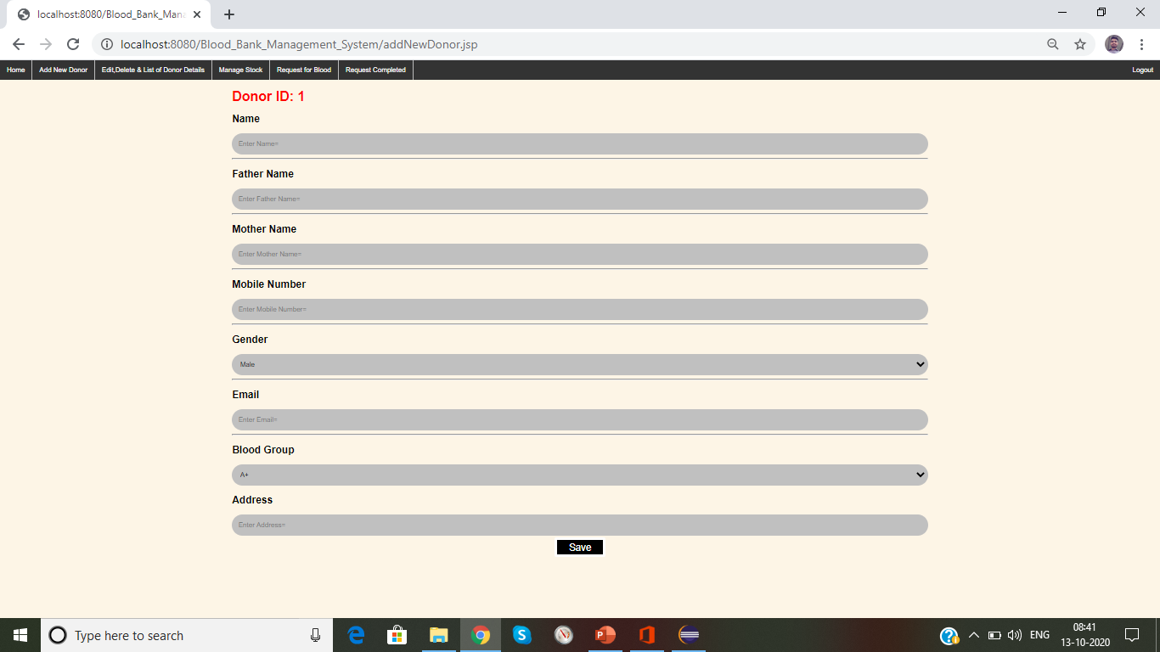
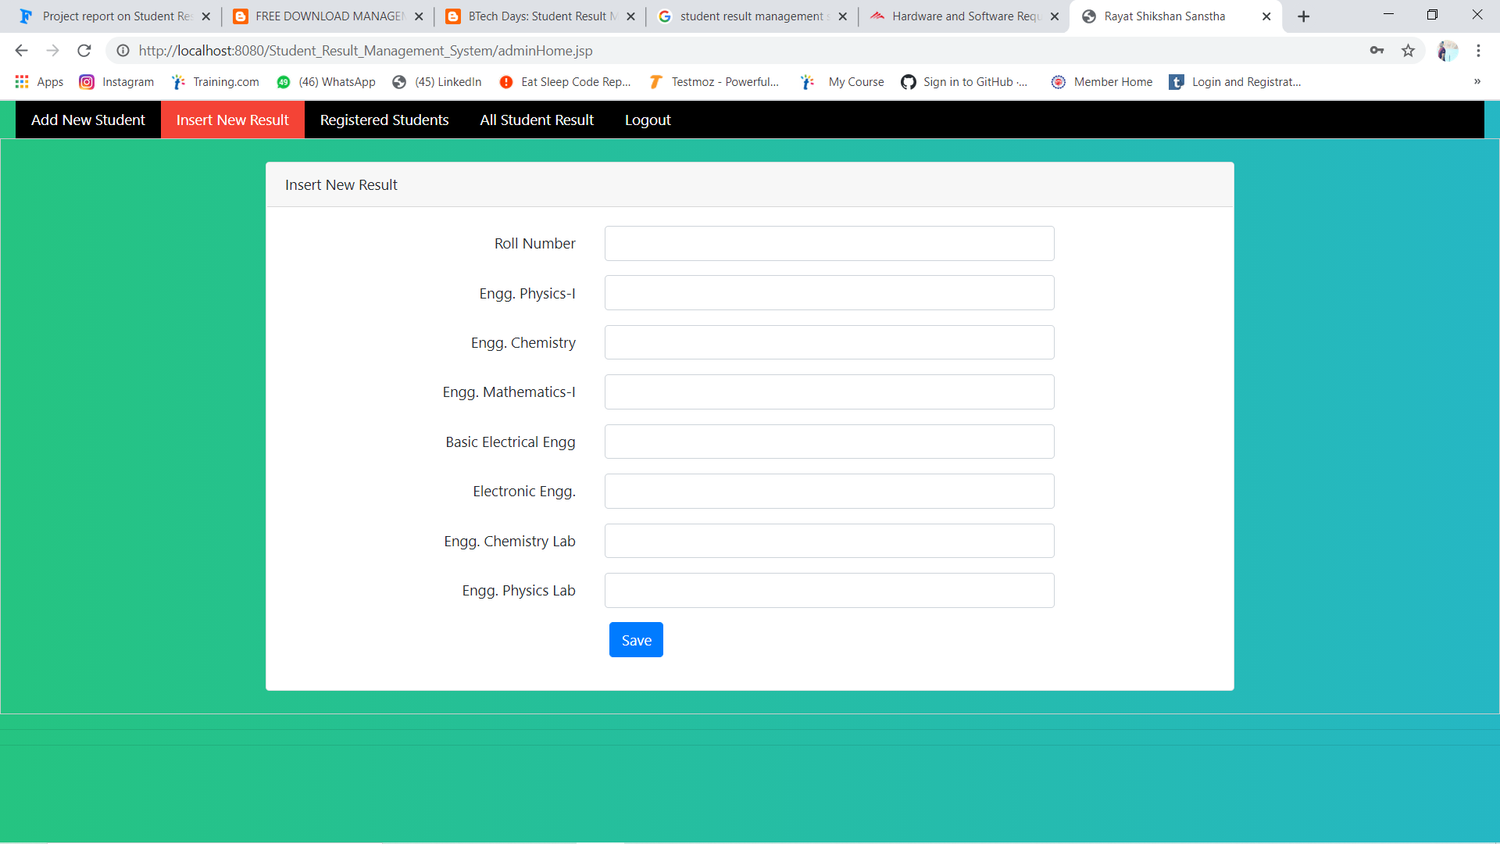

Slide 12
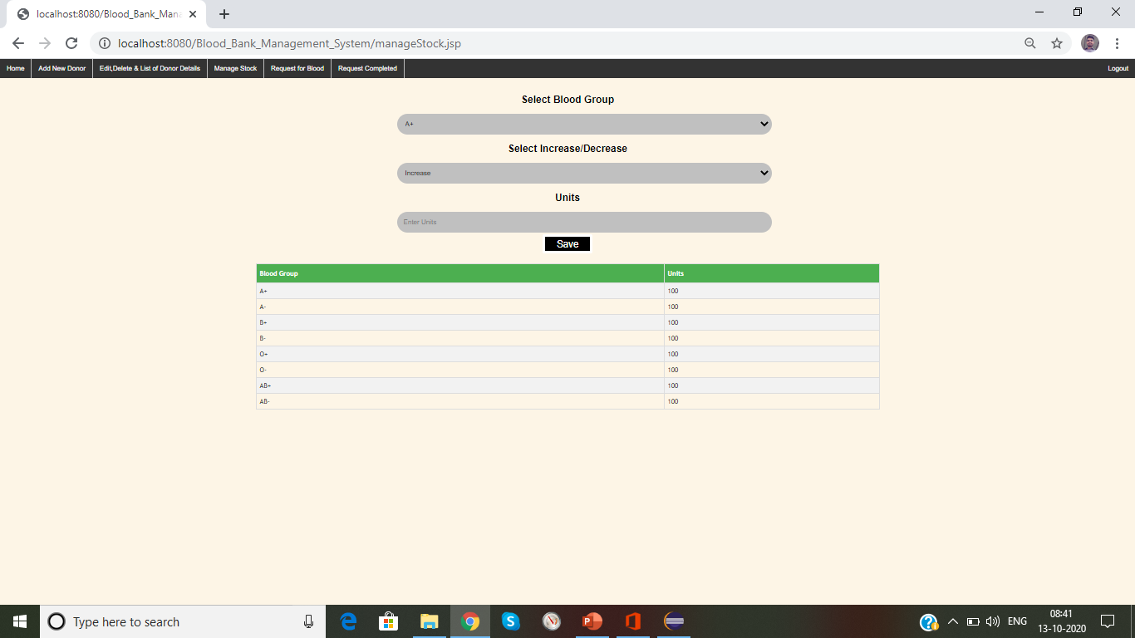
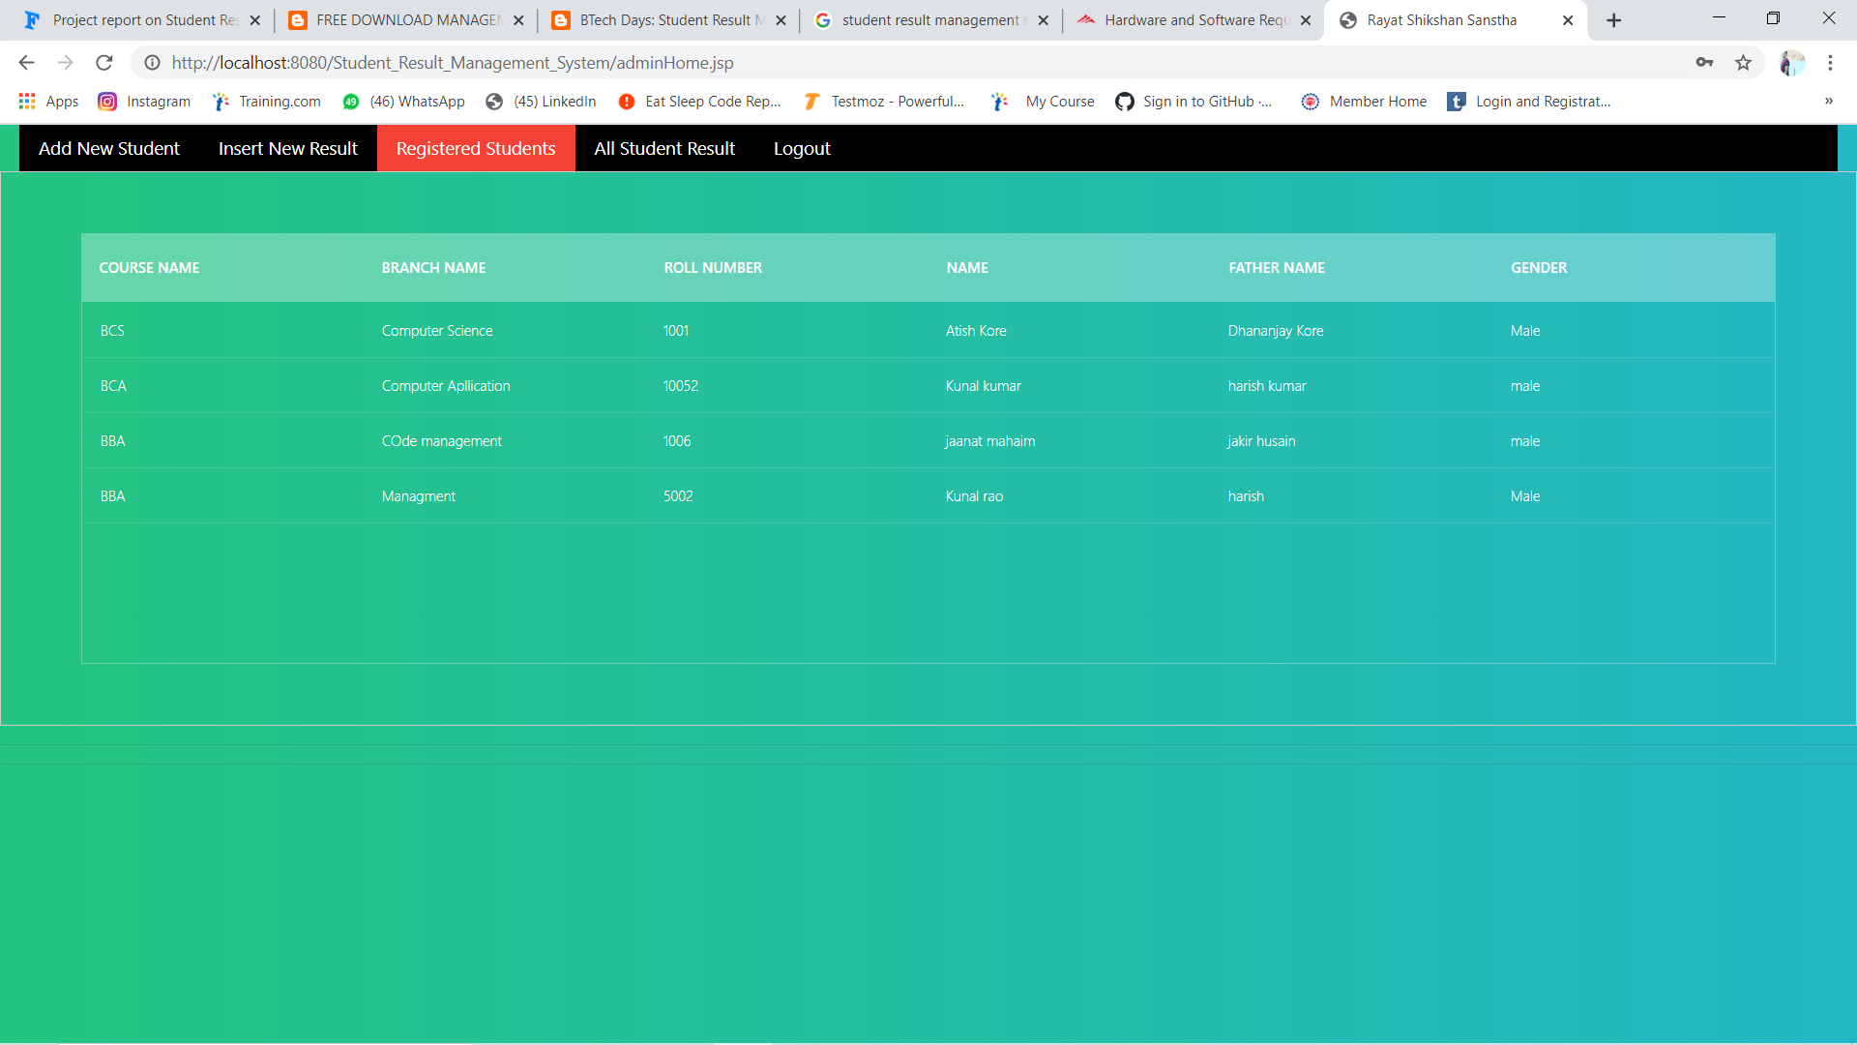

Slide 13
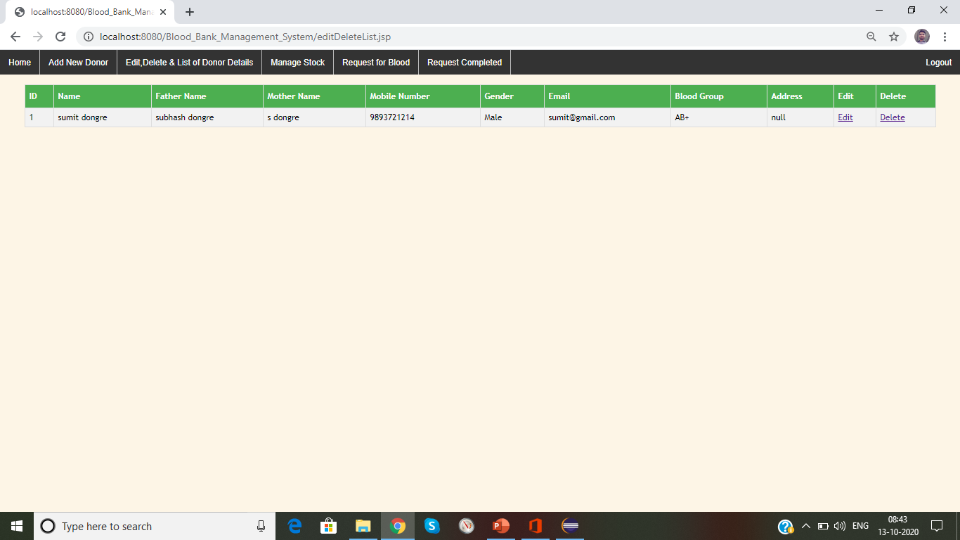
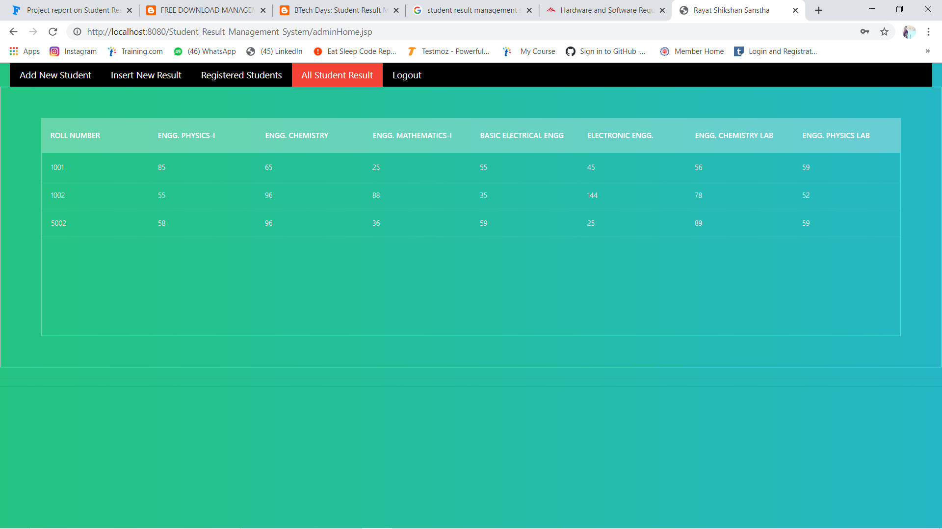

Slide 14
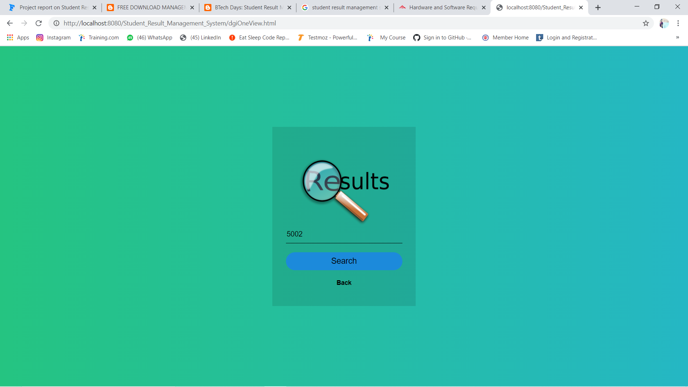
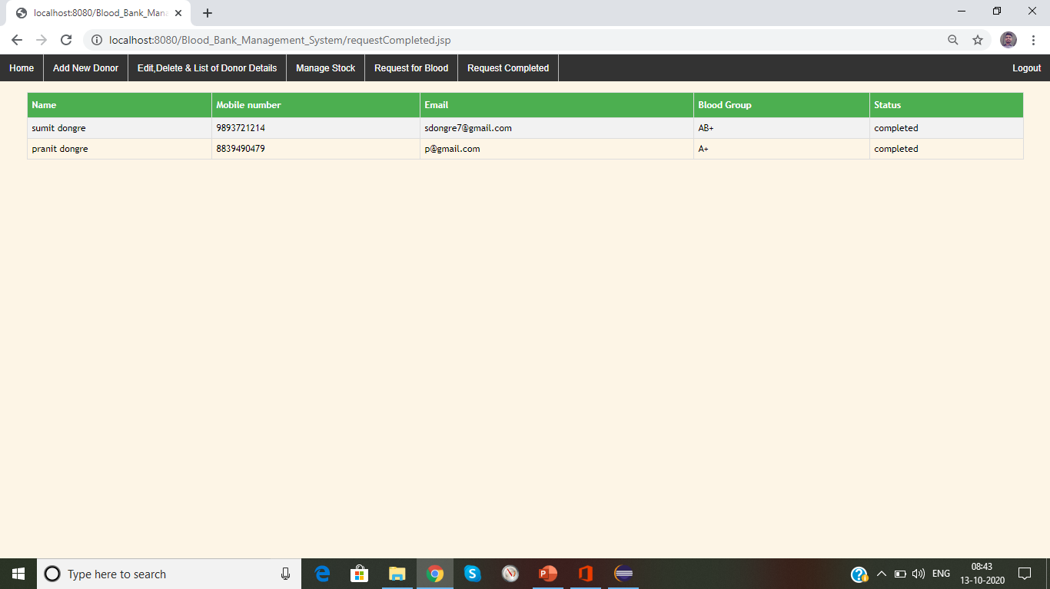
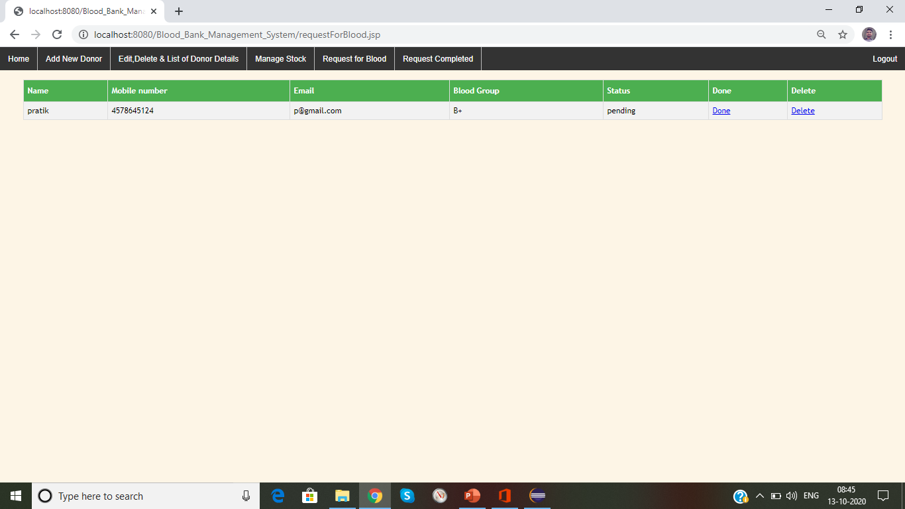

Slide 15
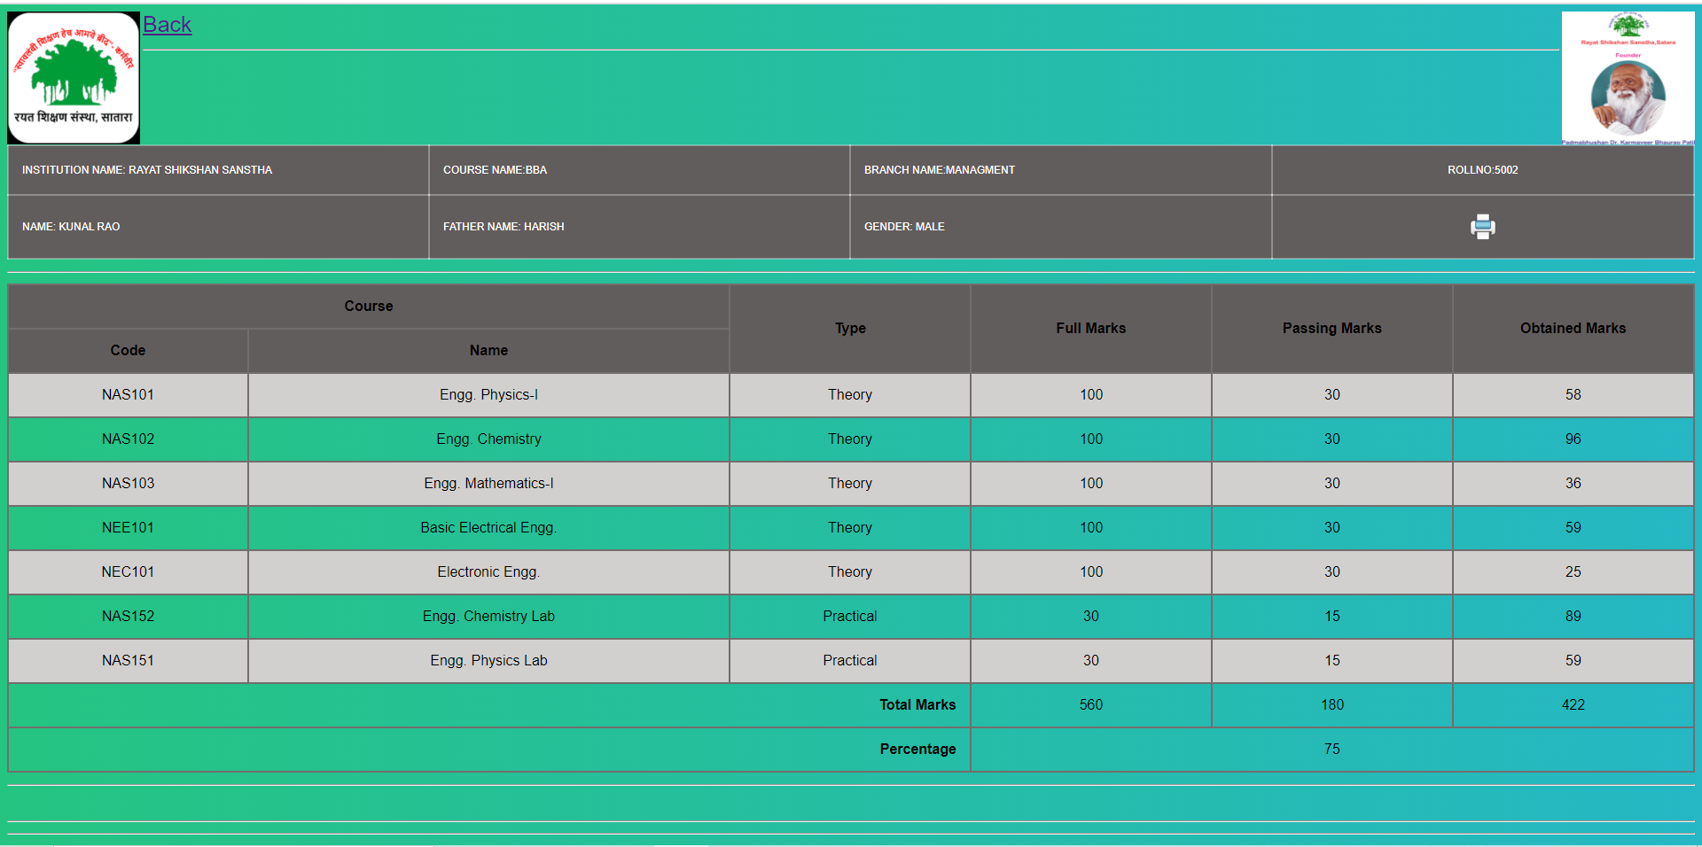

Slide 16
CONCLUSION
A proper analysis of positive points and constraints on the component, it can be safely concluded that the product is a highly efficient GUI based component. This application is working properly and meeting to all user requirements. This component can be easily plugged in many other systems.

